Slide 1
ISG Sprint Engineering Report |
Leonard Daly, Dr. Scott Serich
8 December 2020 - ISG DWG Presentation

Slide 2


Partnership
OGC partnered with Khronos Group for support of glTF
glTF common format for object models
Insertion was usually done with glTF
glTF is a standard format in modeling community

Slide 3
Goal
“Advance the use of relevant OGC and Khronos standards in the modeling and simulation community through practical exercise and testing of the OGC API - GeoVolumes draft specification.”
Test GeoVolumes Draft Specification through
Model & Terrain updates
Alternate Distributions
Structure of underlying 3D Data
Integration with Rapid3D
Integration with Unity game engine
Notes:
Quote from CfP (https://portal.ogc.org/files/?artifact_id=94059).
The first three scenarios were listed in the CfP. The last two were provided by participants and thought worthy of inclusion in the project.
#4 was proposed in conjunction with support of the project sponsor
#5 was deemed important for future OGC and sponsor work

Slide 4
Video

Slide 5
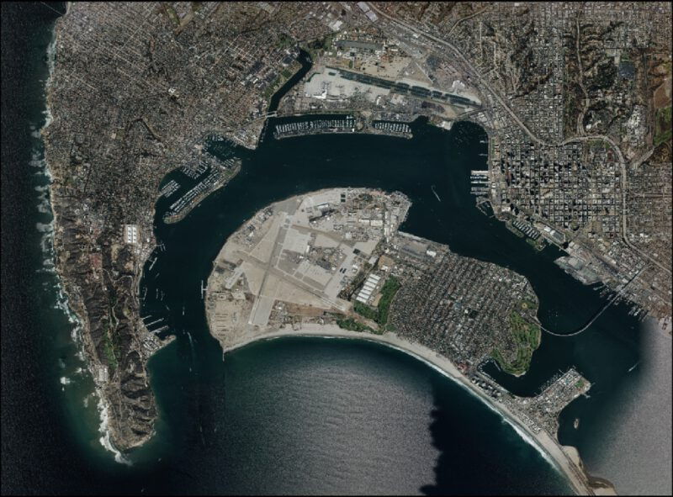
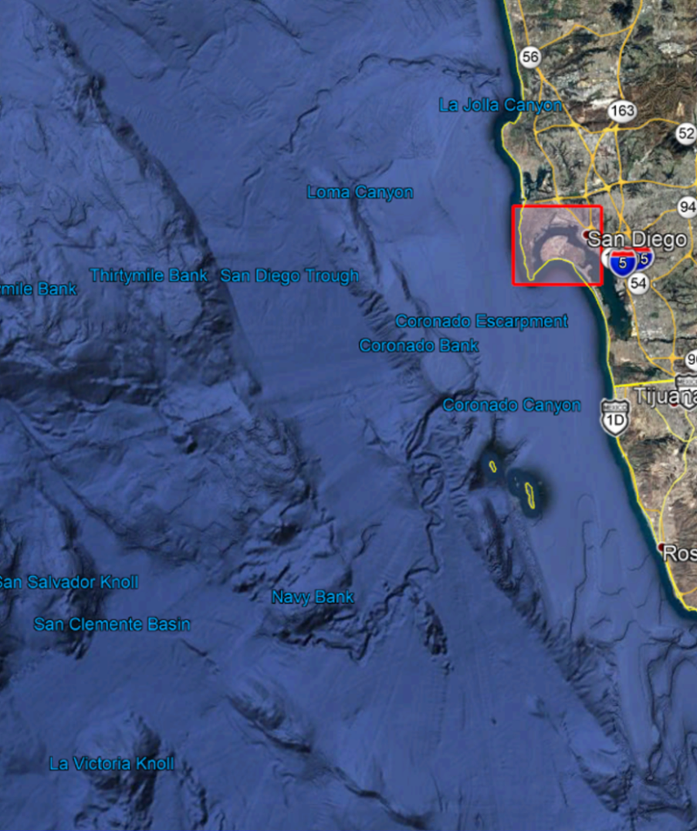
Data Sources
Notes:
Large scale map of Southern California and North-west Mexico showing CDB coverage. The right image is high-resolution imagery of most of the CDB-covered area. Navy facilities occupy much of the region. Other significant are Coronado Bridge (curving bridge over the bay), downtown San Diego (NW of bridge), and Pt. Fermin lighthouse (southern tip of left-most land). Data provided by CAE under direction of the sponsor.

Slide 6
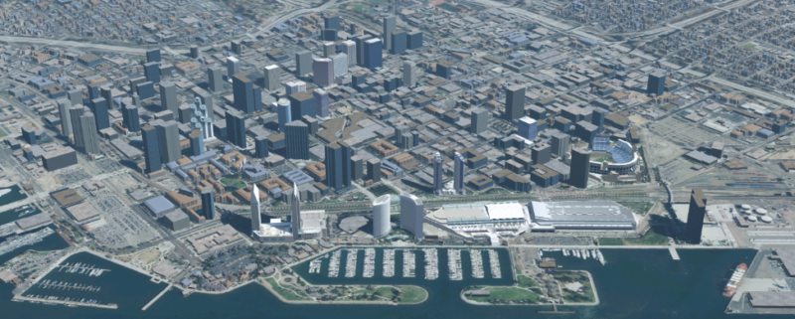
Data Sources - Rendered
Notes:
Rendering of downtown San Diego by CAE. Straight up is North-East. Petco Park is visible in the right-center. The highway on the right leads to the Coronado Bridge.

Slide 7
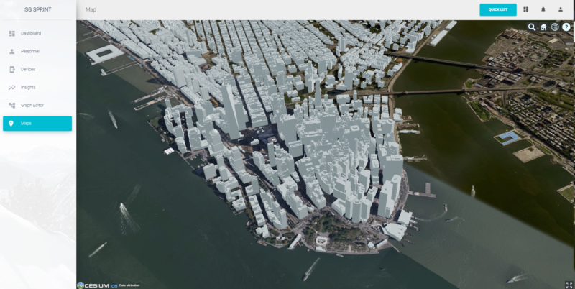
Data Sources - Rendered
Notes:
Two of the participants (InfoDao and SimBlocks) also worked with the New York City CDB data set that was used during the Pilot. The dataset was provided by Ecere.

Slide 8
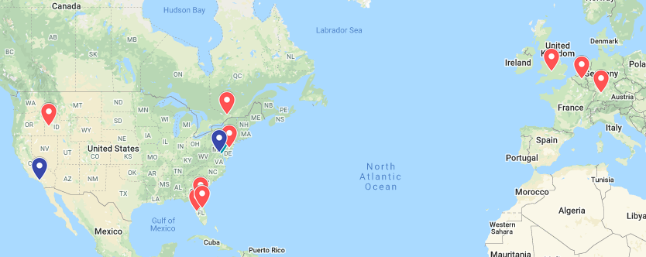
Participants
CAE
Cesium
Cognitics
Ecere
Helyx
Hexagon
InfoDao
SimBlocks
Steinbeis
Notes:
Red flags show location of participants. Blue flags show location of project leadership. A red flag does cover up the project sponsor.

Slide 9
Scenarios
Scenario | Summary Description
S1 | Investigate model and terrain updates
S2 | Investigate alternate and multiple distributions
S3 | Investigate organization of underlying 3D data
O1 | Investigate integration with Rapid3D (Full Motion Video)
O2 | Investigate the integration of GeoVolumes API with Unity game engine
S1-S3: Chapter 5, Discussion of Scenarios
O1: Chapter 7, Cognitics
O3: Chapter 7, SimBlocks
Notes:
S1-S3: https://github.com/opengeospatial/OGC-ISG-Sprint-Sep-2020/blob/master/Sprint%20Report/5-setup.adoc#discussion-of-scenarios

Slide 10
Coverage
Participant | S1 | S2 | S3 | O1 | O2
CAE | ✔
Cesium | ✔
Cognitics |  |  | ✔ | ✔
Ecere | ✔
Helyx |  | ✔
Hexagon | ✔
InfoDao |  | ✔ | ✔ |  | ✔
SimBlocks |  |  |  |  | ✔
Steinbeis | ✔ |  | ✔

Slide 11
Interoperability
Client → | Hexagon | InfoDao | SimBlocks | Steinbeis
↓ Service
Cesium | ✔ | ✔ | ✔ | ✔
Cognitics | ✔ | ⚠ | ✔ | ✔
Ecere | ✔ | ✔ | ✔ | ✔
(Pilot) Ecere | ✔ | ✔ | ✔ | ✔
PyGeoAPI- InfoDao | ✔ | 🔷 | ⚠ | ⛔
Helyx | ✔ | ✔ | ✔ | ✔
Steinbeis New | ✔ | ✔ | ✔ | ✔
(Pilot) Steinbeis | ✔ | ✔ | ✔ | ✔
Technology
Integration
Experiment
(TIE Table from Pilot)
Notes:
Symbology
✔ -- provided data was from San Diego or New York (as appropriate)
⚠ -- Not tested or not applicable
🔷 -- Passing self test
⛔ -- Test failed

Slide 12
Results

Slide 13
What Worked
Successfully used GeoVolumes API with untested dataset
GeoVolumes service hosted on AWS
Integration with other OGC APIs
Dynamic updates of terrain and models
Unity game engine integration

Slide 14
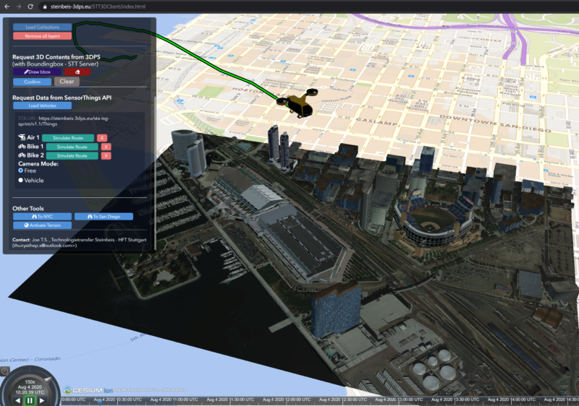
Integration: SensorThings
Notes:
SensorThings (Steinbeis) - Personal air taxi path shown merged with data obtained from GeoVolumes API

Slide 15
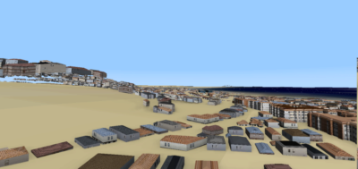
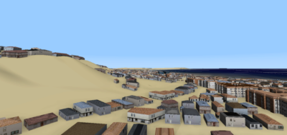
Integration: CDB (Terrain Update)
Uncorrected Model Elevation
Corrected Model Elevation
Terrain update
Models are not relative to terrain (left)
Requires correction (right) to properly position when terrain is changed
Notes:
Terrain update (Hexagon)

Slide 16
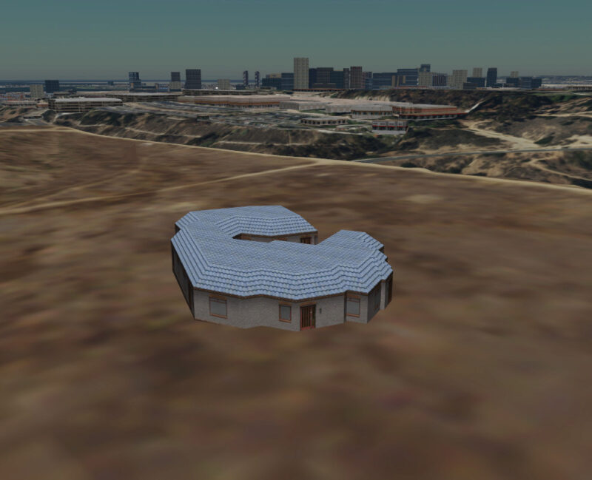
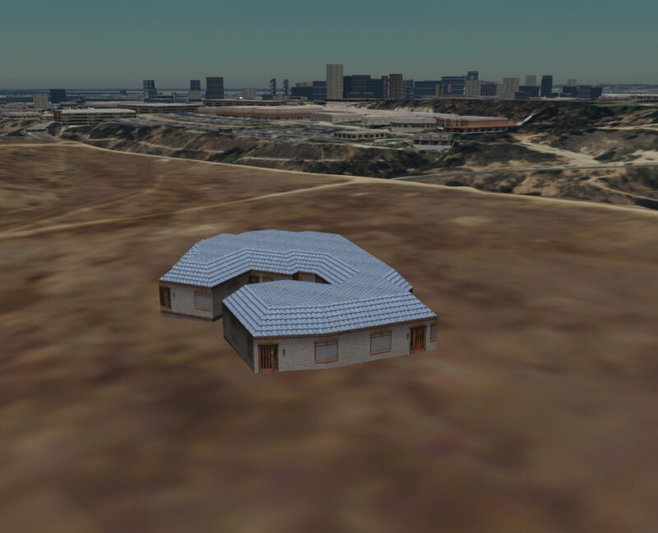
Integration: Features API (Model Update)
Model Update
Initial insert via POST (submit building/feature)
Update (rotate) via PUT (wholesale replacement of building/feature)
Notes:
Model update (Ecere)

Slide 17
Steinbeis Video

Slide 18
InfoDao Video

Slide 19
Concerns
API Common - Part 2: Geospatial Data
Feature API (dataset updates)
Alternate Distributions
End-point specification
Resource
Notes:
Standard datasets can be served from multiple APIs (e.g., GeoVolumes, CityGML, direct). Always using API Common helps ensure that the overlapping API regions are compatible

Slide 20


Concerns: Geospatial Data APIs
API Common - Part 2: Geospatial Data Consistency across multiple OGC APIs so that the entire system operates uniformly.
GeoVolumes API
CDB
Tiles API
Notes:
It is important that OGC APIs adhere to API Common - Part 2: Geospatial Data so that systems that use multiple OGC APIs produce similar and consistent results, independent of the specific API used to access the data.

Slide 21
Concerns: Features
Feature API (dataset updates)
Proper use of HTTP Request Method
Request Methods
GET -- Retrieve data
POST -- Submit feature to datastore
PUT -- Replace feature in datastore
PATCH -- Update feature in datastore
DELETE -- Delete feature from datastore
Notes:
Standard datasets can be served from multiple APIs (e.g., GeoVolumes, CityGML, direct). Always using API Common helps ensure that the overlapping API regions are compatible

Slide 22
Concerns: End-points
End-point specification
Multiple different URLs for accessing same data (Helyx)
Examples (illustrated with 3D Tiles, but others could be used)
https://<domain-path>/3dTiles
https://<domain-path>/bvh?f=3dTiles
https://<domain-path>?f=3dTiles
<domain-path> ~ server.com/collections/SanDiego/SanDiego-buildings
Notes:
Standard datasets can be served from multiple APIs (e.g., GeoVolumes, CityGML, direct). Always using API Common helps ensure that the overlapping API regions are compatible
The GeoVolumes draft standard does not specify which of the numbered items is required or preferred.

Slide 23
Concerns: Resources
Resource are lowest level data categorization
.../SanDiego vs. .../SanDiego/SanDiego-buildings
Term does not align with WWW community
Requesting specific data formats
Use Accept header?
Resolve user conflict with End Points
Registration of media types
E.g., application/json+3dTiles
Does not conform to RFC #6838 (IETF)
Notes:
Work primarily done by Helyx with contributions from Ecere and Steinbeis
This slide highlights items that still need to be resolved within the DWG that interact with the community outside of OGC.
Resources are identified down to city. Handling resources at region or sub-city levels are not fully described. For example water and power typically involve multiple counties or states as sources with service to many cities. The W3C defines a resource as what can be accessed by a URL (*) which is in conflict with the OGC usage of the term.
Request headers need to be resolved with End Points (previous slide)
RFC #6838 (https://tools.ietf.org/html/rfc6838) may require Media Type to be (for example) application/i3d+json
(*) It’s a bit more and different than that simple statement; however, the discussion pretty quickly gets into conflicting philosophies and RFCs. It is almost always sufficient to say a URL identifies a web resource.

Slide 24
Fundamental Question
How distributed and collaborative are these systems suppose to be?
GeoVolumes API
CDB
GeoVolumes API
Tiles API
Notes:
The diagram shows a potential network configuration involving multiple users, servers, and databases. The current draft specification does not provide sufficient information to build (in a standards way) an interoperable multi-user environment. Not all of these apply to GeoVolues as a READ specification; however, when updates are allowed (e.g., Features API), a standard needs to be developed. Research into alternate distributions, either as different URLs or proxy servers was performed by Helyx.
A few of the undefined areas
What to do about multiple locations with same name (e.g., Kansas City)
The language used when naming (English/US, English/UK, local, local-national, etc.)
The character set, especially multi-byte ones
Synchronization across alternate distributions

Slide 25
Future Work
External Work
Khronos
Game Engines (Unity, Unreal)
OGC
Data conversion
GeoVolumes API
Features
Infrastructure

Slide 26
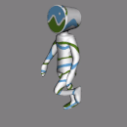




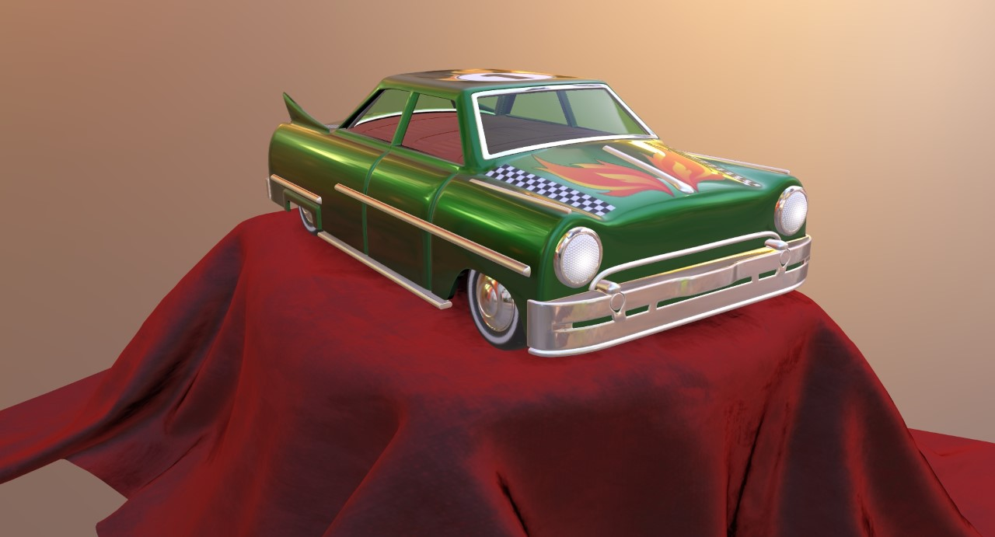
Future Work: External to OGC
External Work
Khronos
Game Engines (Unity, Unreal)
Notes:
Toy car: https://github.com/KhronosGroup/glTF-Sample-Models/tree/master/2.0/ToyCar
Cesium walking man: https://github.com/KhronosGroup/glTF-Sample-Models/tree/master/2.0/CesiumMan
Khronos
Geoposition models (https://www.pngegg.com/en/png-zbhrh)
Use animated models ()
Use advanced rendering ()
Game Engines
Unity (https://unity.com/ )
Unreal (https://www.unrealengine.com/ )
Use VR (https://commons.wikimedia.org/wiki/File:VRHeadset.png )

Slide 27
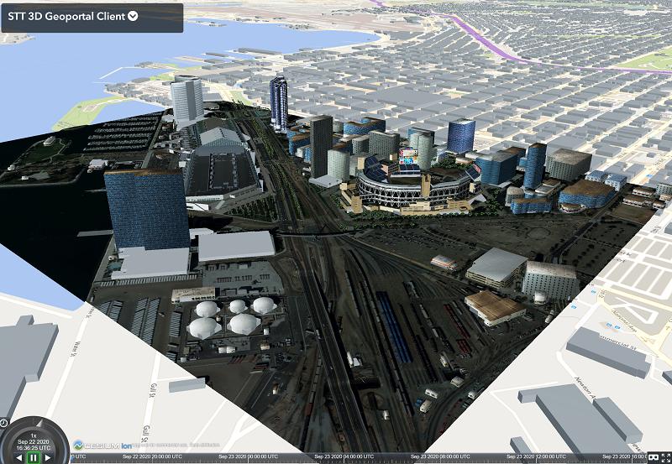
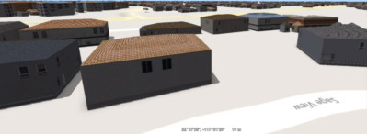

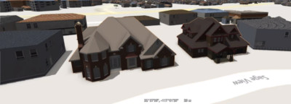
Future Work: OGC
CDB
Data conversion
GeoVolumes API
Features
Infrastructure
OpenFlight
glTF
Converter
3D Tiles

Slide 28
Q&A

Slide 29
References
Khronos and glTF trademark owned by The Khronos Group
Images of San Diego and New York City taken from Sprint Engineering Report contributed by Sprint participants under contract to OGC.
HTTP Request Methods documentation: https://developer.mozilla.org/en-US/docs/Web/HTTP/Methods
Toy car: https://github.com/KhronosGroup/glTF-Sample-Models/tree/master/2.0/ToyCar
Cesium walking man: https://github.com/KhronosGroup/glTF-Sample-Models/tree/master/2.0/CesiumMan
Geoposition models: https://www.pngegg.com/en/png-zbhrh
Unity: https://unity.com/
Unreal: https://www.unrealengine.com/
Use VR: https://commons.wikimedia.org/wiki/File:VRHeadset.png
HTML5 shield: https://www.w3.org/html/logo/

Slide 30
Community
500+ International Members
110+ Member Meetings
60+ Alliance and Liaison partners
50+ Standards Working Groups
45+ Domain Working Groups
25+ Years of Not for Profit Work 10+ Regional and Country Forums
Innovation
120+ Innovation Initiatives
380+ Technical reports
Quarterly Tech Trends monitoring
Standards
65+ Adopted Standards
300+ products with 1000+ certified implementations
1,700,000+ Operational Data Sets Using OGC Standards
Contact info@ogc.org to schedule a meeting for an in-depth discussion with OGC staff and join our community today!
Notes:
If you have any questions, do not hesitate to reach out to OGC or schedule a follow-up. We’re working constantly to change the landscape of location information and want to help your organization get where it needs to go.

Slide 31
Sample Slide

Slide 32
Sample Slide

Slide 33

ISG Sprint
Final
Daly Realism
Creating the Future

Slide 34
Agenda (poor title, but this slide won’t be shown)
Highlights video (1:30 - 3:00 in length)
Goal (verify/review GeoVolumes draft specification)
Overview of data sources
Scenarios & Coverage
TIE table / Interoperability
Results
Mostly everything worked
Demonstrated use of other OGC standards (Steinbeis)
Concerns
URLs
HTTP
Future Work

Slide 35
Highlight Reel
Yet to be built. This will be a summary (via extracts) from the participant videos with some leading and closing titles & credits

Slide 36
Related / Used OGC Specifications
Convert to image layout
Add Steinbeis image showing SensorThings integration
Either additional charts or animate this one with the following
Dynamic updates of terrain
Dynamic updates of models

Slide 37
Concerns: Media Types
Used to
Request data
Unambiguously determine data type (response)
Need to register those in use
See RFC #6838 (§4.2.5 - §4.2.8) for details
Potential mis-labeled values
Provide processing pipeline example to illustrate
Notes:
Work primarily done by Helyx with contributions from Ecere and Steinbeis
RFC #6838 (https://tools.ietf.org/html/rfc6838) may require Media Type to be (for example) application/i3d+json

Slide 38
Concerns: Alternate Resources
Use HTML attributes to specify collection of alternate resources
rel specifies link type (alternate)
type specifies Media Type hint (e.g. application/json+3dTiles)
Examples
Different coordinate systems
Different/Proxy servers
Different dataset versions
Data format conversion
Notes:
Standard datasets can be served from multiple APIs (e.g., GeoVolumes, CityGML, direct). Always using API Common helps ensure that the overlapping API regions are compatible

